Slide 1
Working with Schools

Slide 2
HELLO!
Kirsten Varnum Lane
Secondary Transition Program Facilitator

Slide 3
What we are going to discuss today…
Why is it important?
Notes:
Making the most of partner collaboration
Working with schools – landscape of education and secondary transition
All about relationships
Give ideas about different ways to connect/partner
Happens differently in each situation
It is important, because none of us can do it alone – we all win if we can bring together our collective knowledge, resources, and ideas
Build on todays webinar with part 2, so be thinking about what you might want addressed in part 2.

Slide 4
Understanding
Notes:
It all starts with a solid understanding of each other’s roles, processes, and environments

Slide 5
A Day in the Life of a Teacher
Notes:
Day in the Life of a Teacher
Bathroom
Lunch
30-60 Minute Plan
Required PD/PLC re: content
Parent Communications
Academic demands – “Sometimes a classroom visit is the last thing we can do…
IEP Mtgs

Slide 7
IEP
Individualized plan for each student
Can occur at any time of the year (can be revisited)
Should be a living document
Transition planning begins at age 14
Notes:
Kirsten – not sure what addressing LLW PSEs is and where that goes…
Your notes also said Drives the entire process

Slide 8
6 Parts
Strengths, Preferences, & Interests
Assessment
Course of Study
Services & Supports
Goals
Linkages

Slide 9
Other Outcome Data
Graduation
Dropout
Employment
Higher Education

Slide 10
Adult Service System

Slide 11
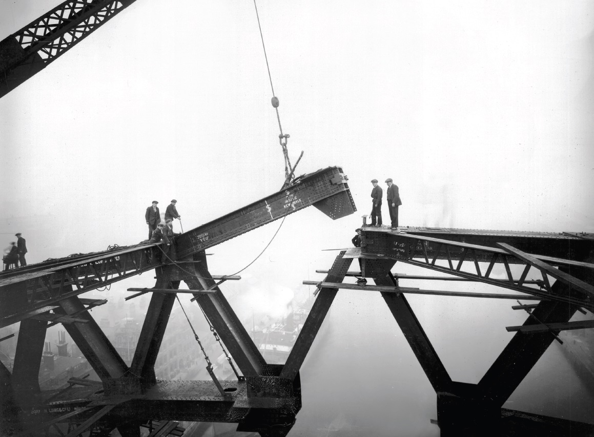
bridging the gap

Slide 12
Bridging the Gap

Slide 13
Bridging the Gap
Secondary Education
Adult Services
“Even though there are similar intentions of these service systems, there are also some significant differences in their structure, rules, processes, & funding.”
Community-Based Services
Children Services
Case Management Services

Slide 14
Some Considerations
Bridging the Gap
Teacher education & preparation
Success is measured in different ways
Competing Priorities
Classroom Visits
Daily Schedules
Contracted Time
Who can invite partners?
Confidentiality

Slide 15
Some Suggestions
Bridging the Gap
Find one person in each school – Relationships, Relationships, Relationships… Did we mention Relationships? They are important!
Know guidelines for schools regarding visitors
Give time to coordinate
Help with understanding the system & services beyond school
Consider innovative ways to partner (parent resource nights)
There is not just one approach
Be prepared to explain what you can bring to the partnership & how you can help the school meet their goals

Slide 16
Now for some discussion…

Slide 17
Unity is strength... when there is teamwork and collaboration, wonderful things can be achieved.
~ Mattie Stepanek

Slide 18
What do you want addressed in part 2?
Tell us what you need…

Slide 19
THANKS!
Any questions?
Kirsten Lane
Secondary Transition Program Facilitator
kirstenlane3107@gmail.com 515.371.3107

