Slide 1
TEAM and Mercy Project SEARCH
Collaborative efforts through IVRS, Des Moines Public Schools and Easter Seals.

Slide 2
Mercy Medical Center Project SEARCH
First time partnering with IVRS and Des Moines Public schools
started in 2012.
Students were able to start work based learning opportunities at
Mercy Hospital.

Slide 3
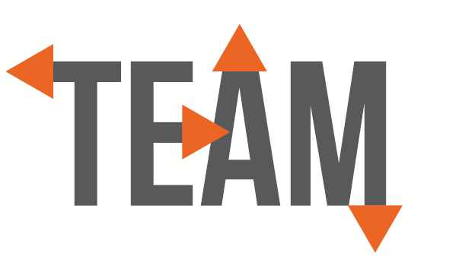
Transitioning to Employment and Advocating for Myself
This contract started in 2017 and allowed for an employment specialist to be in every Des Moines public school to focus on pre employment transition services.

Slide 4
Lessons learned throughout the years
Even though we all have the same goals of
increasing employment for the students that we are
serving, we may all have just a little bit different
idea on how to do it.
It takes time, patience, and understanding.
Each partner may have different cultures,
rules and regulations (IEP’s vs IPP), and may see
another viewpoint.

Slide 5
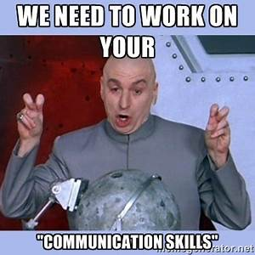
Relationships and communication = successful collaboration
This allows everyone to:
see all points of view
create understanding and work from the same “book”

Slide 6
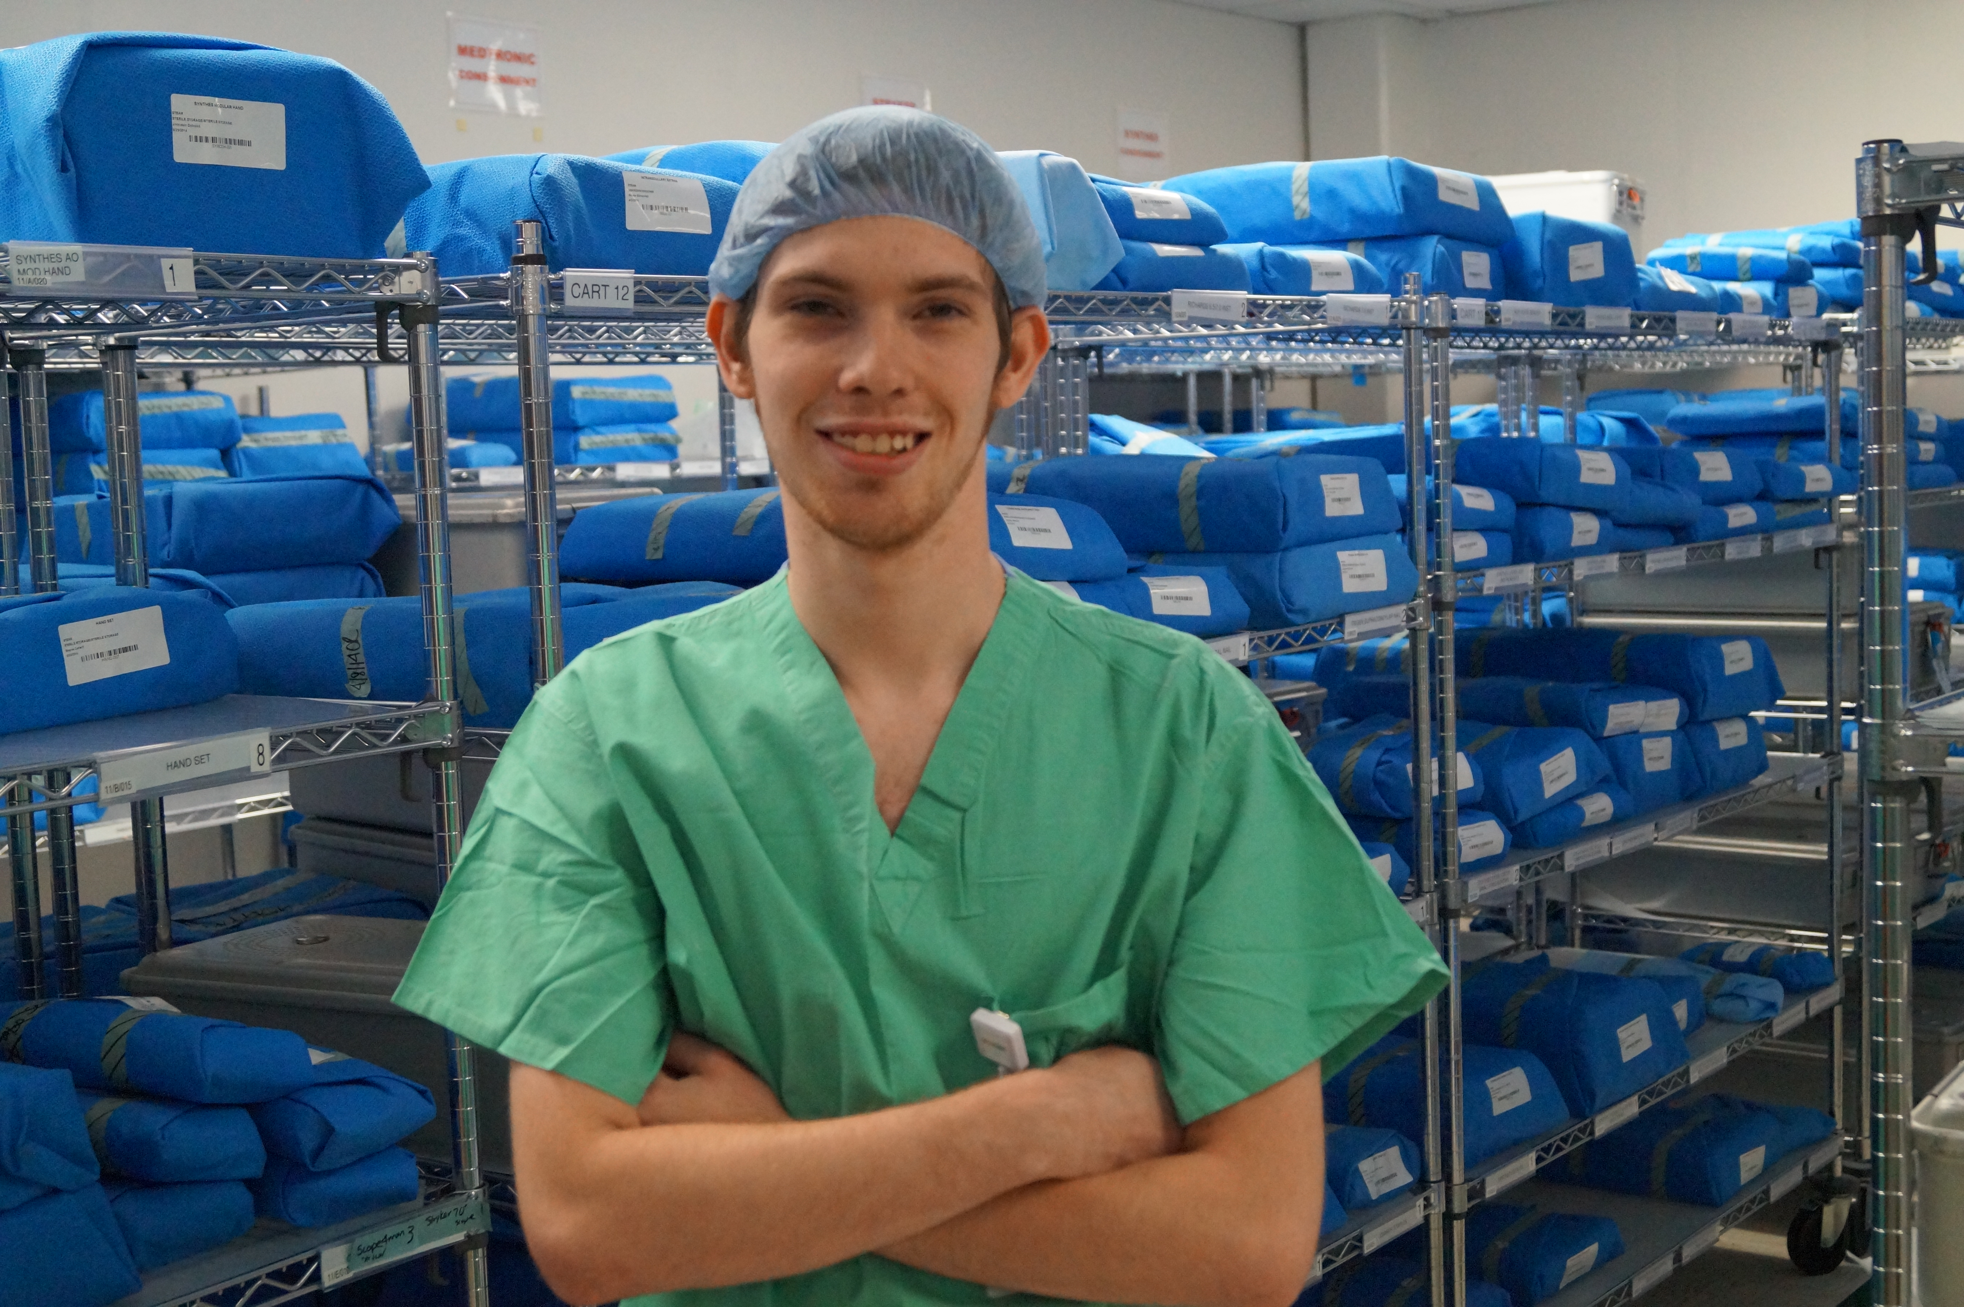
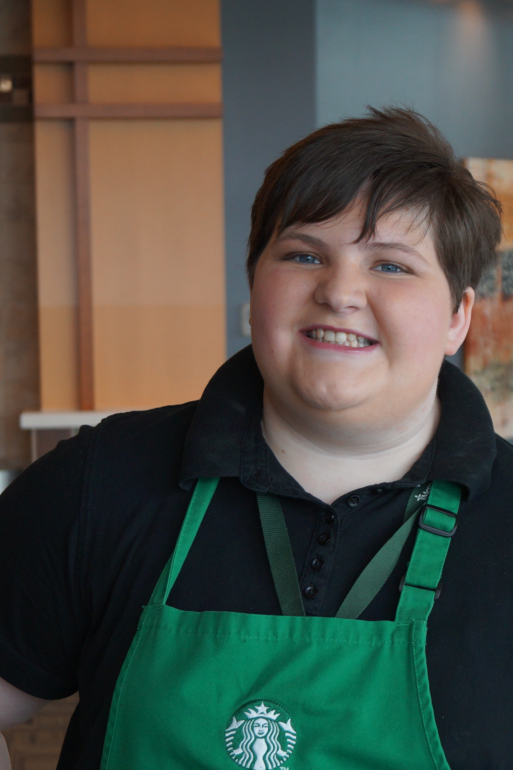
Winning!!!

