Slide 1
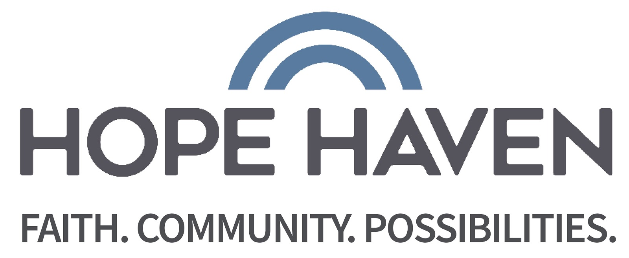
Making the Grade
A collaborative effort brought to you by:
Iowa Vocational Rehabilitation
And
Hope Haven

Slide 2
Establishing Creditability
“It is extremely beneficial to have the IVRS/Making the grade personnel in the building as much as they are. Students enjoy working on the real world activities they bring, as well as see them as common adults in the building that they make connections with the same as day to day staff because of their accessibility in the schools. Having them as part of the day to day team as much as possible helps students transition after high school because they have already built those relationships with those services they will access as adults. At our school, the IVRS/Hope Haven staff are truly part of our team, who work side by side us to help students find success in and beyond school!”
– Tracy Johnson, Spencer Community High School
"Working with Ryan through IVRS has opened doors and opportunities for our students this year within our community and school campus. Our students have learned how to prepare for a job, to be a good employee, to equip themselves with an employment skill set to maintain valuable and viable employment. My Choice has changed my students, they are more confident, self-starting and most importantly they have learned to empower themselves.“
-List Vanderwoude, Spirit Lake High School
“Okoboji High School has been honored to work with Ryan Jenness this year! Having him here for scheduled visits every week, has been an amazing addition to our program. His knowledge and expertise in the area of transition, and the discovery options that he makes possible for our students, has been extremely beneficial. The students look forward to his weekly visits because they relate so well with him. The addition of Ryan has impacted students, parents, and the staff at Okoboji High School. We are very thankful for this partnership!”
-Cherie Harms, Okoboji High School

Slide 3
Student Engagement
Career Camps
Job Shadows
Group and Individual activities based around workplace situations
Social Skills
Mock Interviewing
Team building
Appropriate referrals
Workplace and personal professionalism
Workplace tours
Reverse job fairs
Financial literacy
Paid employment work experiences

Slide 4
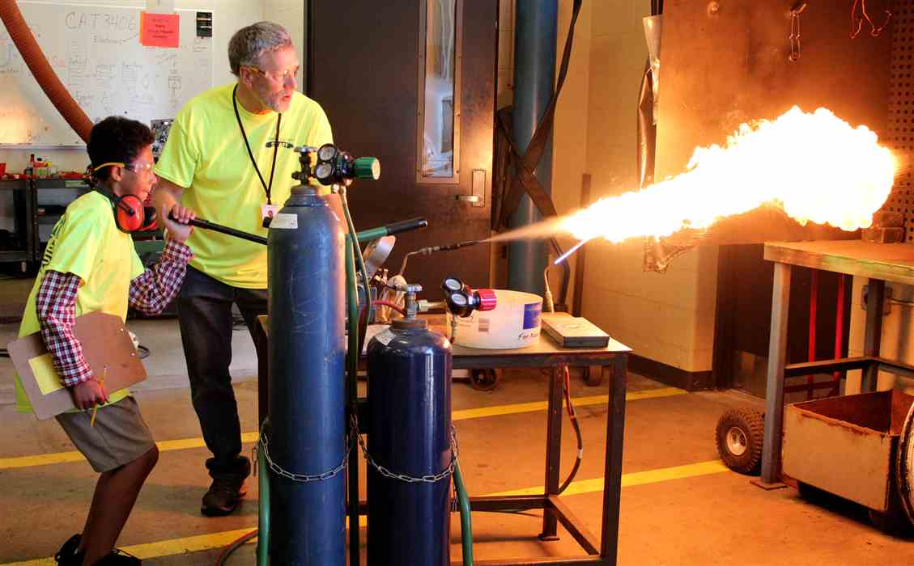
Summer Career Camps

Slide 5
Case 2.0

Slide 6
Connecting Students
To area businesses:
Reverse job fairs
Providing on the job trainings
Work place readiness Assessments at no cost to employers
Job coaching as needed
To opportunities in the area:
College tours
Iowa works
Assistance with making connection to long term supports

Slide 7
Partnership Building
We are eager to build trust to establish more partnerships!
What questions do you have that we can answer?
Molly Giddings, Counselor
Iowa Vocational Rehabilitation, (515)326-4805
Ryan Jenness, Transitional Specialist
Making the grade, Hope Haven
(712) 261-9107

