Slide 1
IHH & Habilitation Provider Training with Amerigroup
Presented: May 2018
This material is designed and intended for general informational purposes only. The user is responsible for determining the applicability and legality of this information and for determining the most recent law, statute or regulation(s) that may be applicable to the user’s particular situation. The Iowa Association of Community Providers assumes no responsibility for the accuracy or legality of the information contained herein.
Relentlessly advocating for Iowa providers to build healthy communities.
Notes:
Slides Presenter
1-6 Emma
7-17 Tricia
18-21 Sara
22 (MDR) Tricia
23-32 Emma
33-38 Sara
39 (example)
1

Slide 2
What we will cover
Authorization requirements
Level of care/Practice/UM guidelines
Considerations when determining tier (assisting member, teaching being done, what the provider is really doing)
Who is your point of contact?
Protocol example
Notes:
IAC 441-78.27 – lists scope of each service under Hab

Slide 3
Annual Review for Habilitation Eligibility
The following are compiled and submitted by qualified IHH staff:
Updated social history
Updated InterRAI
IHH needs to send copies of these to providers
Submission Timeframe:
No earlier than 6 weeks prior to eligibility expiration
Must be submitted prior to expiration
Two weeks prior to expiration is recommended
Notes:
Answer time re: auth for SE when it needs quick turn around . Requests should be emailed to behavior health inbox
Before continued stay review, current InterRAI and Social history must be completed and submitted as part of annual renewal process.
Include why: no earlier than 6 weeks out because of social history and InterRAI.
Consider adding slide on Mediciad Eligibitiy
IHH care coordinator will submit the documentation.

Slide 4
Prior Authorizations for Service Requests
The following are compiled and submitted by qualified IHH staff:
Documentation
Current/Updated Person-Centered Care Plan
Summary of member need
Notes:
Current Social history and current InterRAI before the continued stay review.
AG Provider Manual --avoiding adverse decisions (pg 70)
Avoiding an Adverse Decision
Most administrative adverse decisions result from nonadherence to or a misunderstanding of utilization management policies. Familiarizing yourself and your staff with notification and precertification policies and acting to meet those policies can eliminate the majority of these decisions. Other administrative adverse decisions result from misinformation about the member’s status or the member’s benefits. Such information is readily available from Amerigroup by calling Provider Services at 1-800-454-3730.
Adverse decisions of a medical nature are rare. Such adverse decisions usually involve a failure of the clinical information to meet evidenced-based, national guidelines. Amerigroup is committed to working with all providers to ensure that such guidelines are understood and to identify gaps for providers around meeting such guidelines. Peer-to-peer conversations (between an Amerigroup medical director and the provider clinicians) are one way that Amerigroup is able to ensure the completeness and accuracy of the clinical information and provide a one-on-one communication about the guidelines as necessary. Medical record reviews are another way to ensure that clinical information is complete and accurate. Providers who are able to appropriately respond in a timely fashion to peer-to-peer and medical record requests are less likely to encounter dissatisfaction with the utilization management process. Amerigroup is committed to ensuring a process that is quick and easy; working with participating providers to ensure a mutually satisfying process whenever possible.

Slide 5
Prior Authorizations for Service Requests
Submission Timeframe:
New Service/Tier Change: Submit as need is identified and no later than date of start of care
Continuing Services: Two weeks is recommended, no earlier than 3 weeks prior to service authorization renewal date

Slide 6
Authorization Requirements
Length of authorization is based on clinical need:
Shorter authorizations are given when the members needs are fluctuating or when the clinical need for the requested service is not clear. (Does not clearly meet medical necessity for that tier).
A longer authorization is reflective of being able to identify baseline needs.
Notes:
Usually don’t give less than 30 day. Comes down to documentation and conversations. Give shorter auth rather than send to medical director review in hope more info can be gathered before next authorization.
Collaborative - UM may call IHH, though that call is not required.

Slide 7
Amerigroup Habilitation Guidelines
Let’s review the tier guidelines.
Amerigroup guidelines
Notes:
https://providers.amerigroup.com/ProviderDocuments/IAIA_CAID_HabilitationUtilizationManagementGuidelines.pdf

Slide 8
Clinical Requirements
When looking at guidelines clinical judgment is considered.
For example:
Quantified data to identify member needs
Summary, not 100s of pages of documentation
Include information about how the person’s symptoms impact ability to function
Include interventions that become “routine”
Staff intervention to keep a person out of crisis
How is their ability to do normal activities impacted?
Notes:
Hundreds of pages of daily notes doesn’t help.
Summarize with quantified data to back up. What were staff doing on the daily to emeliorate the issue. Give selves credit for what you are doing. Acutiy.
INSERT LINK

Slide 9
Supporting Clinical for Service Requests
Summary of member‘s needs
Clinical Terminology
Supporting Recovery information
Explaining the ”why” (barriers)
Notes:
Not trigger words, or key words. However, need more than basic info on what the person did during the day (he played video games all day).
Clinically, how a many hours a day are you interveening.
What does the day look like for that person on a typical day? Supports needed to help them get through a typical day. What is the member doing.

Slide 10
Barriers to Recovery
Barriers will be key to the “WHY” we are doing what we are doing. We need to describe why we are supporting the goals they’ve identified as well as the need for protective oversight and supervision.
Notes:
Reference the Clinical and support needs listed in the IHH/CM plan as well as the assessment. Can even say as identified in the InterRai or SIS.

Slide 11
Barrier to recovery example
Due to Sally’s high level of anxiety, she is not able to live alone without support. With in the last 6 months, when she was living without overnight support, she would frequently (3-4 times per week) contact the emergency rooms and/or call 911 due to fears that occur when alone…

Slide 12
Barrier to recovery example cont’d.
...When anxious she bangs head against objects until skin breaks and cuts self requiring stitches. For her safety, overnight support and supervision are required to reduce anxiety.

Slide 13
Authorization Requirements
The challenge for everyone is getting to know the member and his/her needs.
Everyone’s job is to paint the picture to the person who is reviewing - remember they have never met the member.
If you do not know the person use information from people who know the member well and/or rely on records.

Slide 14
Painting the Picture
Let Utilization Management know what was authorized last time.
Why previous supports were approved...
What is different or the same now?
If no progress, what interventions will be implemented or need to be maintained?

Slide 15
Painting the Picture, cont’d
Supporting Clinical Need for Service
What does the day look like for that person on a typical day? Supports needed to help them get through a typical day.
What does the staff do during the day to teach the member how to cope?
What does the staff do during the day to help member manage in the community?
Answer What? Where? When? Why? and How?
Notes:
Staff need to take credit for what they are doing - state how they are helping - what aret they teaching the member

Slide 16
Authorization Requirements
Accurate and specific Documentation is critical
Person Centered Care Plan need to be current and specific/ restrictions need to be current
IHH Documentation needs to be current and specific to the needs of the member and reflect what the staff is doing to help/teach
Relate member behaviors and needs to the tier they need
Behaviors and needs of member need to be clear in the Habilitation provider documentation (specific staff interventions)

Slide 17
Authorization Requirements
Looking for: Process/behaviors/actions/interventions/outcomes
What are the specific needs of the member?
What are the specific things that the staff is doing to teach skills?
What are the outcomes of interventions?
TIP: Be sure to use language that demonstrates intervention

Slide 18
Common Intervention Terminology
https://theiacp.memberclicks.net/assets/docs/May2018IHHAmerigroup/CommonInterventionTerminologyinDocumentation.docx

Slide 19
Authorization Requirements
Sometimes it is an issue of math….how much time is actually being spent with the member in significant interactions and interventions, and how many hours in the day to access all the services being requested.
Example:
Members who are in day HAB 6-7 hours and have no issues overnight/sleeping and have a job for 4 hours a day does not leave enough time for the highest tiers time frames

Slide 20
Things to consider regarding service time
Day Hab program attendance
Work hours
No needed interventions overnight
Time away without paid supports
Volunteering
Natural supports
Time in the community
Other

Slide 21
Authorization Requirements
Timeliness of events need to tie to current authorization timeframe.
How does the medical issue impact the mental health of the member?
Document to this standard
Notes:
Information provided to support Habilitation requests should be timely and relevant. This may vary member to member. A hosptialization will not automatically qualify for the highest tier. Be sure to include details as to what happened, how it affected the member's mental health, and how the service will help prevent or minimize these occurances in the future.
-Badgley, Emma

Slide 22
Medical Director (Physician) Review
What is this? How is it used?
If the Utilization Care Manager is unable to authorize a service, Amerigroup sends to psychiatric medical director to review for final decision.
These reviews are done in writing
A decision is made within 1 business day
Notes:
Magellan did review calls where verbal explanations could be given. Is this possible? Now has to be written
Goal is to make a call out and gather additional information. If you approve and the Hab provider will accept the approved tier,. During that time period, provider and IHH staff can then work together to gather additional inforation to support higher tier.
Giving at least 24 hours for HH to call back the UM person. They prefer to be able to have the clinical support documentation.

Slide 23
Examples of Considerations in Determining Tiers
Has this member been hospitalized for a mental health reason? How long since the last hospitalization? What is actively being done in the home to keep member out of a higher level of care?
Can this member be left alone for a period of time without supervision? Are 15 minute check/bed-checks a requirement for safety? Are staff required to be awake all night and do bed checks for safety?
Notes:
DOCUMENTED CLEARLY IN THE SERVICE PLAN WHAT THE MEMBERS SERVICE NEEDS ARE. WHAT IS DOCUMETNED IN THE SERVICE PLAN SHOULD BE IN ASSESSMENT. PROVIDER PLAN SHOULD INCLUDE SPECIFIC LANGUAGUE THAT IS DETAILED AROUND SUPPORT AND SUPERVISION NEEDS. IF NOT GETTING SERVICE PLAN, NEED TO CALL PROVIDER LIASION. IF ALL OF THAT DOES’NT WORK, BRING MEMBER ID, NAME, MCO, CASE MANAGER BRING TO DEPARTMENT.

Slide 24
Examples of Considerations in Determining Tiers
Is this member making comments about self-harm or harm to others?
When was the last time this member talked about or actively engaged in self-harm to themselves or others?
Does the member superficially cut themselves?
What does staff do to help member cope with thoughts of self harm or harm to others?

Slide 25
Examples of Considerations in Determining Tiers
Is this member displaying psychotic behaviors? (Hearing voices, hallucinations, talking without meaning or structure, unable to make sense of anything…etc)
What does staff do to help member cope with psychotic behaviors? How often does member need assistance with psychosis?

Slide 26
Examples of Considerations in Determining Tiers
Is there a recent incident?
How many incident reports have been done for this member in the last 6 months?
How long has it been since the last incident report?
Is there a written statement by a psychiatrist or PCP justifying the level of care being requested?

Slide 27
Examples of Considerations in Determining Tiers
Is the member sleeping well at night?
Do they sleep during the day?
What are staff doing to help keep the member busy and not want to sleep?
Does the member sleep a lot due to inability to cope with mental health or due to physical illness?

Slide 28
Examples of Considerations in Determining Tiers
What daily activities are staff providing and working on with the member?
What is the staff doing to teach independence and coping?
Does the member chose to not participate in activities due to inability to cope with symptoms or for personal preference (self determination)?

Slide 29
Examples of Considerations in Determining Tiers
Is the member eating nutritious meals?
Does the member need staff to cook and encourage the member to eat?
Are they able to cook things independently?
What is the staff doing to teach independence?

Slide 30
Examples of Considerations in Determining Tiers
Is the member managing their hygiene well?
Do they require regular prompts?
How often are they doing these things?
What is staff doing to teach the member? (Showering, washing
clothes, washing hands, grooming…etc)

Slide 31
Examples of Considerations in Determining Tiers
How much direct supervision and monitoring does the member need?
What does this specifically look like for the individual member?

Slide 32
Examples of Considerations in Determining Tiers
What activities does the member participate in to get out of the house? Does the member engage in these activities or do staff have to prompt these?
Does the member have any current medical concerns that are being monitored? How does the medical condition influence the mental health needs?

Slide 33
Collaboration with other Service Providers and Funders
Day Habilitation Providers
Employment Providers
Therapists
Peer Support
Medical Providers
Voc Rehab
Other people important to the member
Have a way to document this collaboration - This should happen as often as needed to meet the members needs.
Notes:
CHANGING HOURS OF SUPERVISION NEEDS TO BE AN IDT DECISION AND DETERMINATION. HAS THE REST OF THE FAMILY BEEN CONSULTED? HAVE THE NEEDS REALLY CHANGED?
VOC REHAB

Slide 34
After the Tier is Authorized…..
IHH and Habilitation Providers need to assure they have a defined process for monitoring service authorization.
If you are unsure of how to access authorizations:
Habilitation providers contact your provider rep
IHH contact ia-healthhome@amerigroup.com

Slide 35
Typical Frequency of Review
U9 – UD - 1 to 3 months
UC – UA - 4 to 6 months

Slide 36
Check Your Work
Providers need to QA their documentation
No cutting and pasting
Did you articulate in writing what the person needs and what is going on?
Tip: Identify mentors in your staff to support new people or people who
struggle with documentation to gain these skills.

Slide 37
Develop Internal Review Process
Identify the frequency of review
Document collaboration with other service providers
Maintain and document communication with team/IHH care coordinator
How are you going to assure process is implemented?

Slide 38
Point of Contact
Topic | Amerigroup
Questions about Habilitation Services in General | Provider Relations Department (“Find Your Provider Representative” tool on the Amerigroup Provider Website, https://providers.amerigroup.com/ia/Pages/ia.aspx )
Questions about Specific Members’ Services | Work through the Member’s IHH or CBCM Member Services: 1-800-600-4441
Questions about Claims | Provider Relations Department (“Find Your Provider Representative” tool on the Amerigroup Provider Website, https://providers.amerigroup.com/ia/Pages/ia.aspx )
Notes:
IAC 441-78.27 – lists scope of each service under Hab

Slide 39
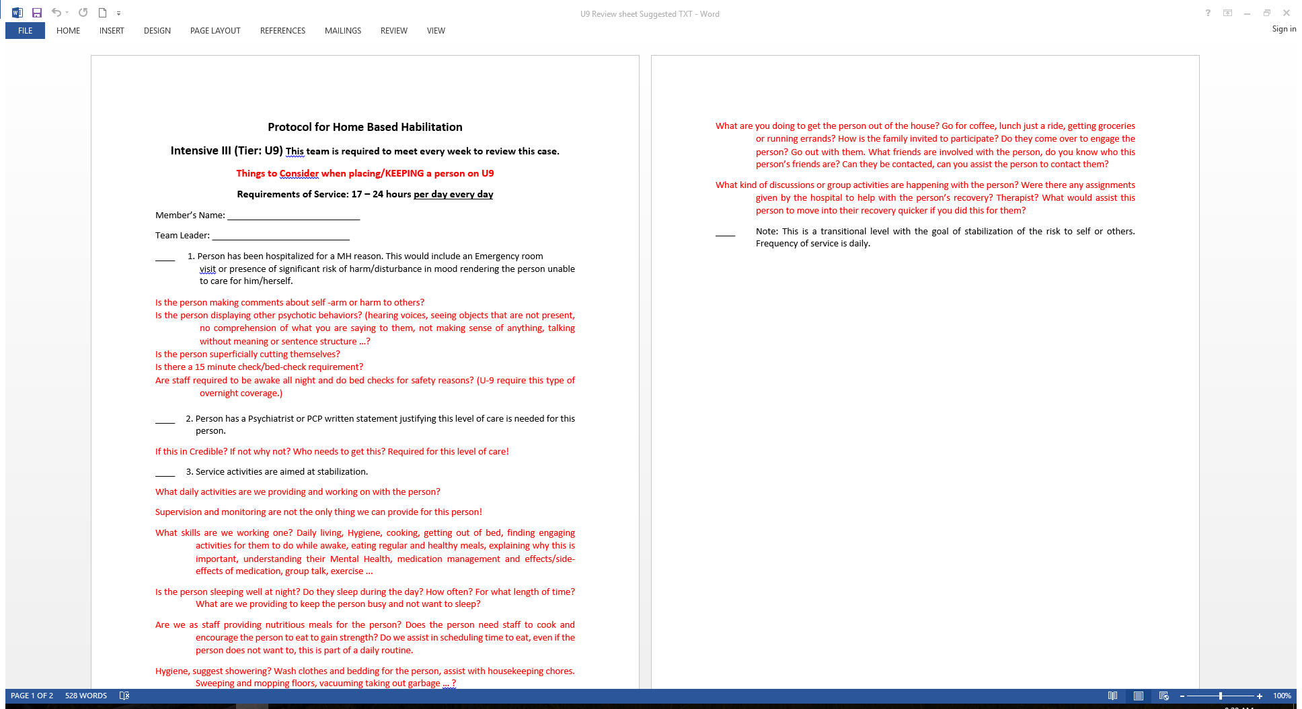
Notes:
Review sheet – questions under 1 – 3. Stress importance of assuring documentation shows how we are focusing on stabilization.
ADD LINK FOR PAGE

Slide 40
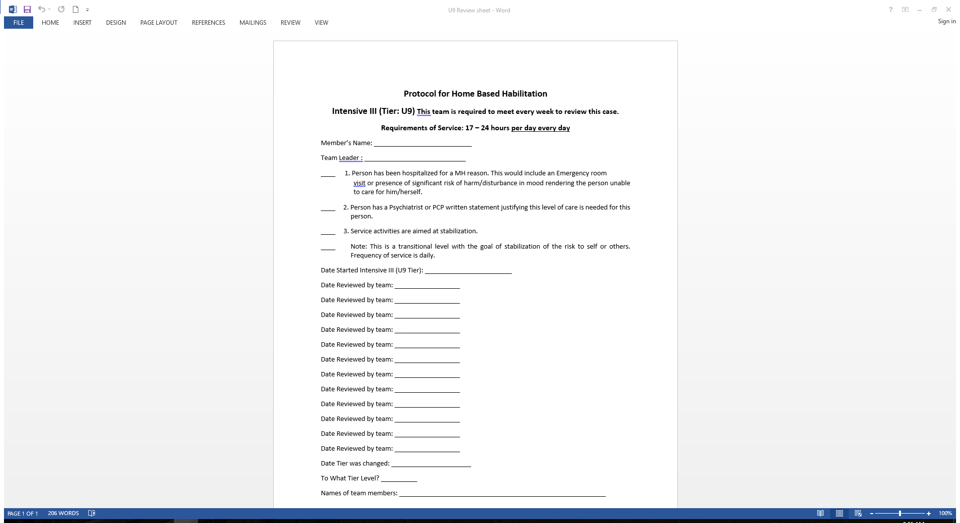
Notes:
ADD LINK FOR PAGE

Slide 41
Questions

Slide 42
Links
https://theiacp.memberclicks.net/assets/docs/u7_review_sheet_txt.docx
https://theiacp.memberclicks.net/assets/docs/u8_review_sheet_suggested_txt.docx
https://theiacp.memberclicks.net/assets/docs/u8_review_sheet.docx
https://theiacp.memberclicks.net/assets/docs/u9_review_sheet_suggested_txt.docx
Https://theiacp.memberclicks.net/assets/docs/u9_review_sheet.docx
https://theiacp.memberclicks.net/assets/docs/May2018IHHAmerigroup/Examples.pdf

Slide 43
Links
https://theiacp.memberclicks.net/assets/docs/May2018IHHAmerigroup/IACP%20PCP%20for%20Review.pdf
https://theiacp.memberclicks.net/assets/docs/May2018IHHAmerigroup/DaisyPlan(2).docx
https://theiacp.memberchttps://theiacp.memberclicks.net/assets/docs/ABCTierFormH2016U9.docx
https://theiacp.memberclicks.net/assets/docs/IHHToolU7.8.9.docxs.
https://theiacp.memberclicks.net/assets/docs/HabTierUD.8.9doc2017.06withprompts.docx
https://theiacp.memberclicks.net/assets/docs/May2018IHHAmerigroup/CommonInterventionTerminologyinDocumentation.docx

Slide 44
Thanks to All Who Helped!!!
Amerigroup:
Emma Badgley
Jamie Ferguson
Sara Hackbart
David Klinkenborg
Tricia Tentinger

Slide 45
Thanks to All Who Helped!!!
IACP:
Diane Brecht
Lori Bush
Gayla Harken
Andrea Lietz
Brita Nelson
Erin Rand
Stephanie Schmidt
Lisa Schwanke
Angela Wacker
Karen Walters Crammond

