Slide 1
Supporting Transition-Aged Youth A Deeper Look at Partner Collaboration
Schools
AEAs
Iowa
Vocational Rehabilitation Services
Community
Rehabilitation
Providers

Slide 2
WELCOME
Why are we here today…

Slide 3
Hello!
Kirsten Varnum Lane, Iowa Department of Education
Mary Jackson, IVRS
Mindy Burr, Easter Seals
Toni Tewes, Hope Haven, Rock Valley
Ryan Jenness, Hope Haven, Rock Valley
Molly Giddings, IVRS
Hostesses with the Mostesses
Amy Desenberg-Wines, IACP & ICIE
Gayla Harkin, IACP

Slide 4
1.
IVRS
Investment in youth & partner collaboration…

Slide 5
Pre-Employment Transition Services (Pre-ETS)
What is this?
How is it different from the past?
Who does it apply to?

Slide 6
IVRS Partnerships with Schools

Slide 7
Need for Transition-Focused Services
What does this actually look like…
Whole different ballgame
Potentially eligible
What we need
What makes a good match for our needs

Slide 8
Examples of IVRS Partnerships
Contracted Programs
Menu-of-Services
IVRS
Schools
CRPs

Slide 9
2.
Schools
An education lens…

Slide 10
“Never doubt that a small group of thoughtful, committed people can change the world. Indeed. It is the only thing that ever has.”
~ Margaret Mead

Slide 11
How could schools benefit from partnerships with VR and CRPs?

Slide 12
It’s
important!
Work-Based Learning

Slide 13
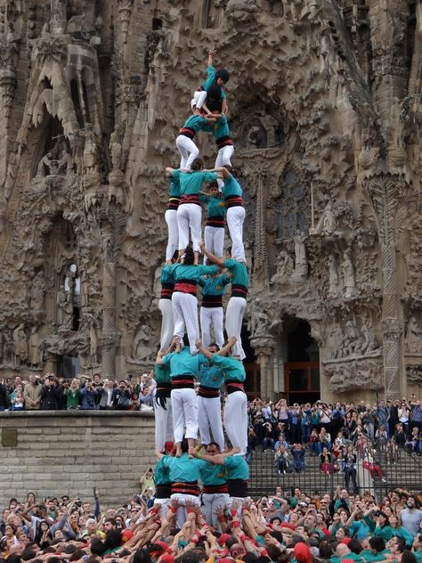
Remember to share…
Some examples of school partnerships

Slide 15
3.
A Closer Look
From the field…

Slide 16
Discussion Time
Please share any lessons learned from your work that might inform others who want to collaborate to support transition-aged youth
Have you expanded your relationship with other schools in your service area?
Are there any resources you have found to be really useful when doing transition focused work?

Slide 17
4.
Everyone Join In
A bit more discussion…

Slide 18
Whole Group Discussion
What are characteristics to consider when finding the right staff for working with transition-aged youth?
So what options might be available to partners who want to do something in their community – where would you start?
Recommendations & Transition Service Wish Lists

Slide 19
Any questions?
Feel Free to Contact:
Amy Desenberg-Wines
adesenbergwines@gmail.com
Phone: 515.981.4113

Slide 20
5.
Thanks!
For joining us…

